Slide 1
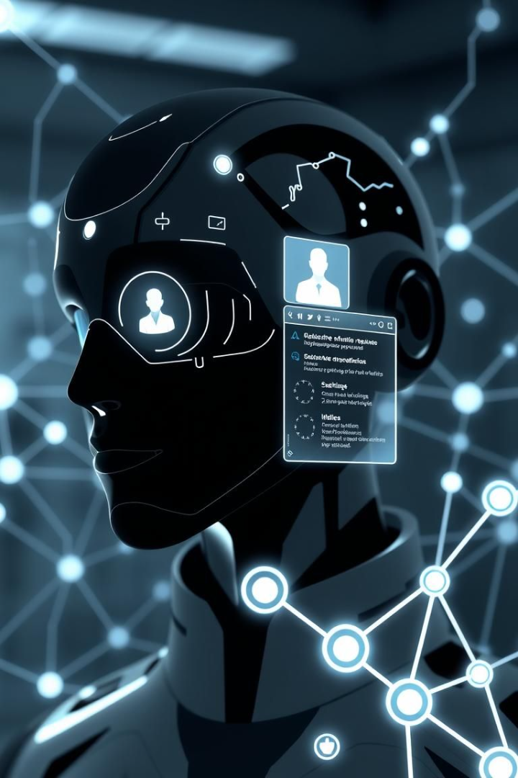
AI-Powered Resume Screening
Fair, efficient, and transparent recruitment solutions.
Name :
Student ID :
Date : 3/24/2025
Notes:
Hi everyone, my name is Muhammad Ameer Hamza, and today I’ll be presenting my project proposal titled “AI-Powered Resume Screening for Job Recruitment.”

Slide 2

Project Context: Background & Problem
1
Traditional Screening
2
Recruiter Challenges
Time-consuming, inconsistent, biased.
Handling large application volumes.
3
AI Potential
4
Growing Need for
Automate and standardize process.
fair, efficient, and transparent recruitment solutions
Notes:
Traditional resume screening is slow, inconsistent, and often biased. HR teams spend hours going through applications, and even then, good candidates can get overlooked. With growing job applications and limited time, companies need smarter, faster, and fairer ways to shortlist candidates. That’s where AI comes in — to help make recruitment more efficient and unbiased.

Slide 3
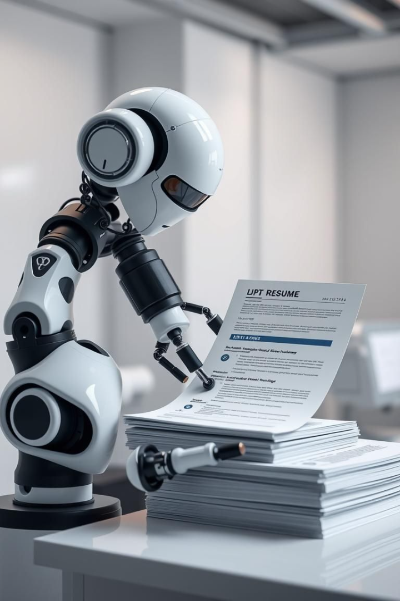
Aim
To develop an AI-based resume screening system that ensures accurate, efficient, and unbiased candidate shortlisting.
Notes:
The aim of my project is to build an AI-based system that can automatically screen and rank resumes.

Slide 4




Objectives
NLP Extraction
Extract key resume information.
Evaluate
AI performance vs. human screening
ML Matching
Match resumes to jobs.
user-friendly interface
frovide for HR teams.
Bias Detection
Detect and reduce bias.
HR system integration
Support it
GDPR/EEOC
Ensure compliance.
Notes:
I’ll extract skills and experience from resumes using NLP, and match them to job descriptions using machine learning. I also plan to include fairness checks, compare results with human screening, and make sure the system is legally compliant, user-friendly, and easy to integrate into existing HR software.

Slide 5
Business Case
Market Needs
Benefits
Dis-benefits
Rising demand for AI in HRTech.
Reduces workload, hiring delays.
Risk of data bias.
Quick, unbiased , compliant tools.
Data-driven decisions.
Non-compliance consequences.
improves fit and fairness
Black-box nature reduce user trust.
Notes:
There’s a growing demand for AI in HRTech because companies want faster, more accurate hiring processes. The benefits of this system include saving time, improving fairness, and making data-based decisions. However, there are risks — such as bias in the training data, or people not trusting AI decisions. Also, if the system doesn’t follow GDPR or EEOC rules, it could be a legal issue. That’s why legal compliance and transparency are built into the project from the start.

Slide 6
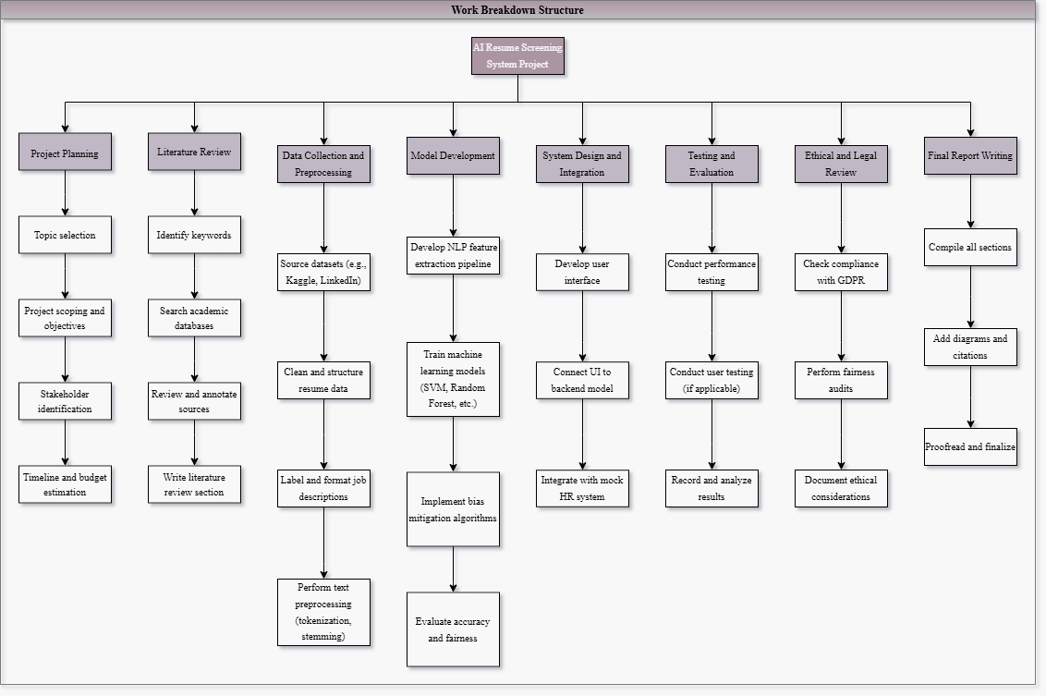
Work Breakdown Structure
Eight major deliverables and related tasks.
Notes:
Here’s the Work Breakdown Structure. The project is divided into 8 main parts — from planning and literature review to data collection, model development, testing, and final reporting. This helps keep the project organized and on schedule.

Slide 7
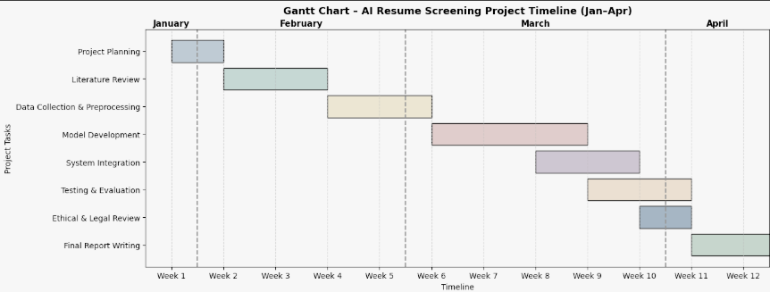
Gantt Chart
Project timeline with tasks and deadlines.
Notes:
The Gantt chart shows the full 12-week timeline. I start in January with planning and research, then build and test the system through February and March, with the final report due before the April 4 deadline.

Slide 8

Literature Review
Title
Method
Pros
Cons
Li et al. (2023)
Bias audit in DL
Fairness focus
Only one bias type
Devlin et al. (2019) – BERT
NLP contextual model
State-of-the-art embeddings
Computationally expensive
Priyanka & Parveen (2024) – DeepSkillNER
Deep learning + NER
Strong skill extraction
No integration testing with HR tools
Moore et al. (2023)
Human bias eval
Real-world HR data
Not automated system
Notes:
I reviewed papers on bias audits, deep learning, and NLP models. For example, Li et al. (2023) studied how AI can be biased against nationality. Priyanka and Parveen (2024) created a model that extracts and ranks resume skills. BERT by Devlin et al. is a powerful NLP model that understands resume context. Moore et al. (2023) highlighted how human screening can also be biased, showing the need for AI support.

Slide 9

Critical Discussion:
1
ATS uses
2
Underdeveloped areas.
keyword filters, ignoring semantic context.
Bias mitigation and explainability
3
This project closes these gaps
using NLP + fairness audits.
Research Question Example:
“How effective is AI in reducing bias and increasing accuracy compared to human screening?”
Notes:
Many systems today use simple keyword filters, which can ignore important context. Also, many don’t focus on fairness or explainability. My system will fix this by using advanced NLP and adding fairness checks. A key research question I explore is: “How effective is AI in reducing bias and improving hiring accuracy compared to humans?”

Slide 10
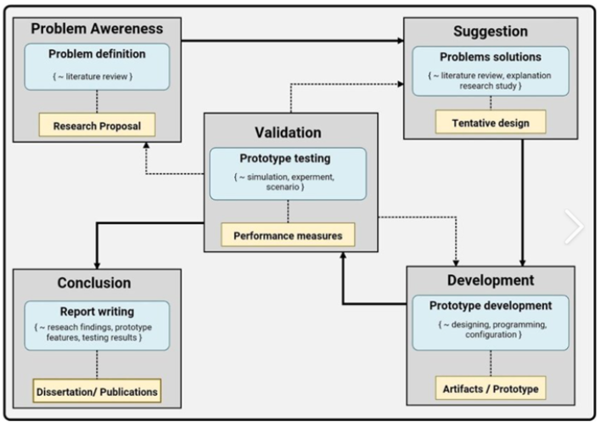
Design Science Research Methodology
Notes:
My project uses the Design Science Research framework, which follows six steps: Problem identification, literature review, design and development, demonstration, evaluation, and communication. This method helps create practical solutions while staying research-focused. I’ll use data from Kaggle and LinkedIn, apply machine learning models, and evaluate results using accuracy and fairness metrics.

Slide 11
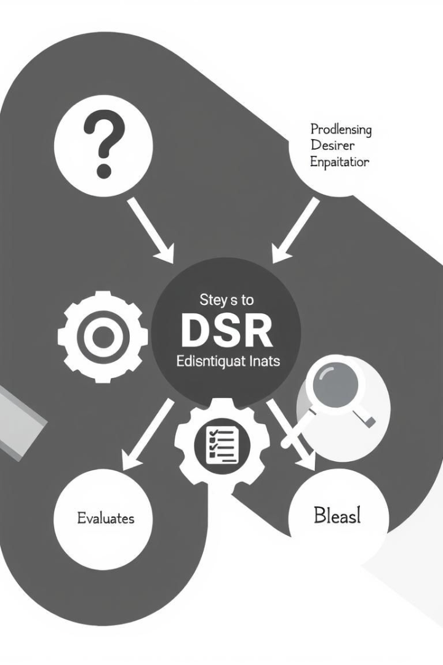



DSR Framework: Core Steps
Problem Identification
Literature Review
Design and Development
Demonstration
Evaluation
Communication
Notes:
2

Slide 12




Expected Results
Accurate Screening
Shortened Time-to-Hire
Achieve more accurate and unbiased resume screening.
Reduce the time it takes to hire new employees.
Legally Compliant
Ensure explainable and legally compliant decisions.
Notes:
I expect this system to provide faster and more accurate hiring decisions. It should help reduce bias and allow HR teams to trust the AI’s output. However, balancing performance and fairness will be a challenge. I’ll use tools like SHAP and fairness-aware ML to improve transparency.

Slide 13
Discussion: Validation and Challenges
Validation
Key Challenge
Validated using existing tools.
Finding balance in empirical performance and fairness.
BERT
SHAP
Fairness-aware ML
Notes:
5

Slide 14

Self-Reflection: Skills Developed
NLP and ML
Literature Review
Gained skills in NLP and ML implementation for recruitment.
Improved skills in literature review and model comparison.
Ethics and Compliance
Learned about ethics and compliance in AI.
Notes:
Through this project, I’ve learned a lot about NLP, machine learning, and ethics in AI. I also improved my research and project planning skills. In the next 2 years, I plan to finish my degree, apply for a Master’s in Data Science, and gain industry experience through internships. I want to focus on responsible AI, especially in recruitment.

Slide 15
Future Plans: Academic Goals
Intern with HRTech firm
1
focusing on responsible AI
Enroll in MSc
2
Enroll in an MSc program in Data Science.
Notes:
7

Slide 16

Conclusion
Key Contributions
Limitations Addressed
Fair, explainable AI tool.
Keyword-based ATS systems.
Ethical Recruitment
Promoted through transparency.
Notes:
In conclusion, this project aims to solve a real HR problem using AI. It’s designed to be fair, efficient, and transparent. In the future, I want to expand it to include soft skill detection, support multiple languages, and integrate it fully into enterprise HR systems.

Slide 17

References
Li, S., Li, K. and Lu, H., 2023. National origin discrimination in deep-learning-powered automated resume screening. arXiv preprint arXiv:2307.08624.
Priyanka, J.H. and Parveen, N., 2024. DeepSkillNER: An automatic screening and ranking of resumes using hybrid deep learning and enhanced spectral clustering approach. Multimedia Tools and Applications, 83(1), pp.1–20.
Moore, O.A., Livingston, B. and Susskind, A.M., 2023. Résumé screening heuristic outcomes: An examination of hiring manager evaluation bias. Equality, Diversity and Inclusion: An International Journal, 42(1), pp.21–38.
Devlin, J., Chang, M.W., Lee, K. and Toutanova, K., 2019. BERT: Pre-training of deep bidirectional transformers for language understanding. In: Proceedings of the 2019 Conference of the North American Chapter of the Association for Computational Linguistics: Human Language Technologies. Minneapolis, Minnesota, 2–7 June 2019. ACL, pp.4171–4186.
Notes:
8

Slide 18

Thank You !
Any Questions ?

